Slide 1
Accelerating Systems with Programmable Logic Components Lecture 12 Neural network II Part 2
1DT109 ASPLOC
2021 VT1-VT2
Yuan Yao, yuan.yao@it.uu.se

Slide 2
Agenda
Corollary 2
Corollary 3
Corollary 4

Slide 3

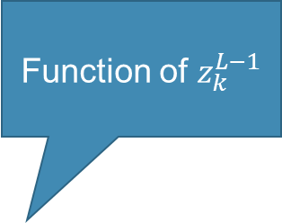




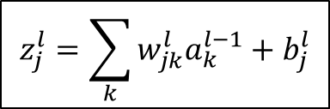

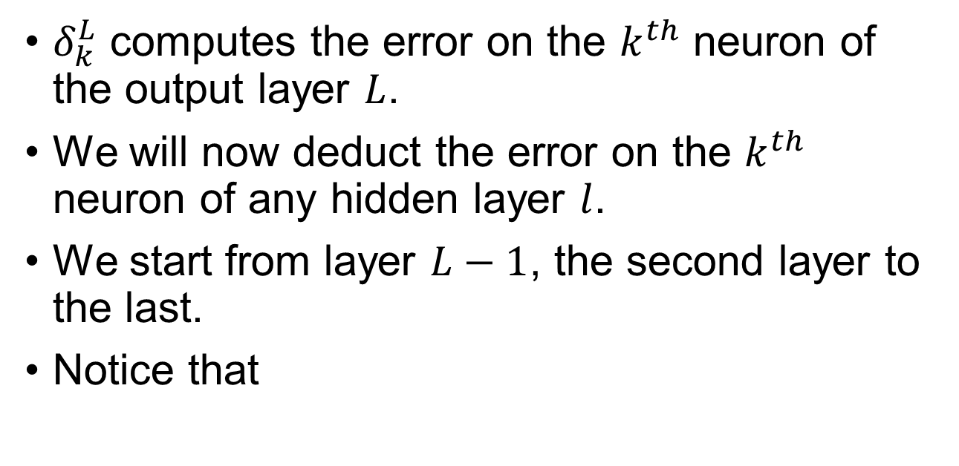


Backpropagation – Corollary 2
$δ_{k}^{L}$ computes the error on the $k^{th}$ neuron of the output layer $L$.
We will now deduct the error on the $k^{th}$ neuron of any hidden layer $l$.
We start from layer $L−1$, the second layer to the last.
Notice that
$$a_{j}^{l}=σ\left(z_{j}^{l}\right)$$
$$z_{j}^{l}=\sum_{k}{w_{jk}^{l}a_{k}^{l−1}}+b_{j}^{l}$$
$$C_{x}=\frac{1}{2}\sum_{j}{{\left(y_{j}−a_{j}^{L}\right)}^{2}} \\ =\frac{1}{2}\sum_{j}{{\left(y_{j}−σ\left(z_{j}^{L}\right)\right)}^{2}} \\ =\frac{1}{2}\sum_{j}{{\left(y_{j}−σ\left(\sum_{k}{w_{jk}^{L}a_{k}^{L−1}}+b_{j}^{L}\right)\right)}^{2}}$$
Function of $z_{k}^{L−1}$
$$a_{1}^{L}, y_{1}$$
$$C_{x}$$
$$j$$
$$a_{j}^{L}, y_{j}$$
$$k$$
$$σ\left(z_{j}^{L}\right)$$

Slide 4
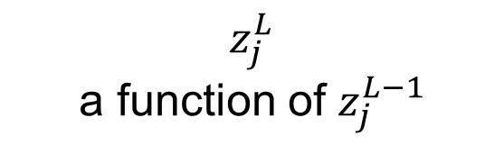

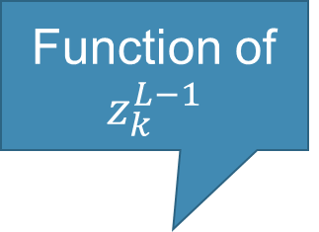

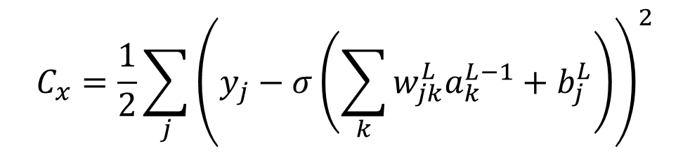
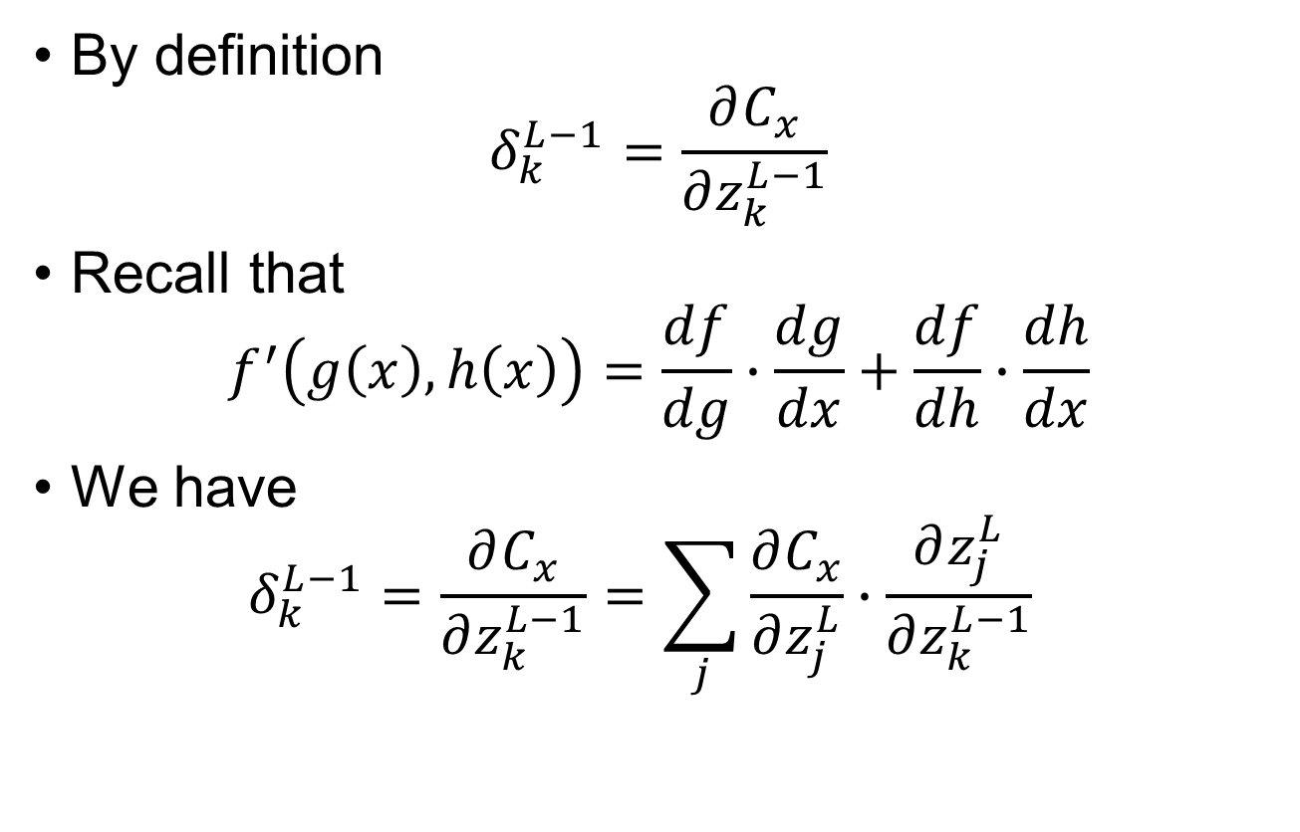
Backpropagation – Corollary 2
Function of $z_{k}^{L−1}$
$$C_{x}=\frac{1}{2}\sum_{j}{{\left(y_{j}−σ\left(\sum_{k}{w_{jk}^{L}a_{k}^{L−1}}+b_{j}^{L}\right)\right)}^{2}}$$
By definition $δ_{k}^{L−1}=\frac{∂C_{x}}{∂z_{k}^{L−1}}$
Recall that $f^{′}\left(g\left(x\right),h\left(x\right)\right)=\frac{df}{dg}∙\frac{dg}{dx}+\frac{df}{dh}∙\frac{dh}{dx}$
We have $δ_{k}^{L−1}=\frac{∂C_{x}}{∂z_{k}^{L−1}}=\sum_{j}{\frac{∂C_{x}}{∂z_{j}^{L}}∙\frac{∂z_{j}^{L}}{∂z_{k}^{L−1}}}$
$z_{j}^{L}$ a function of $z_{j}^{L−1}$
$$a_{1}^{L}, y_{1}$$
$$C_{x}$$
$$j$$
$$a_{j}^{L}, y_{j}$$
Directive at layer L
“Backpropagate” to layer L-1
$$k$$
$$σ\left(z_{j}^{L}\right)$$

Slide 5
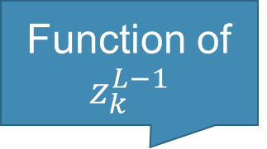

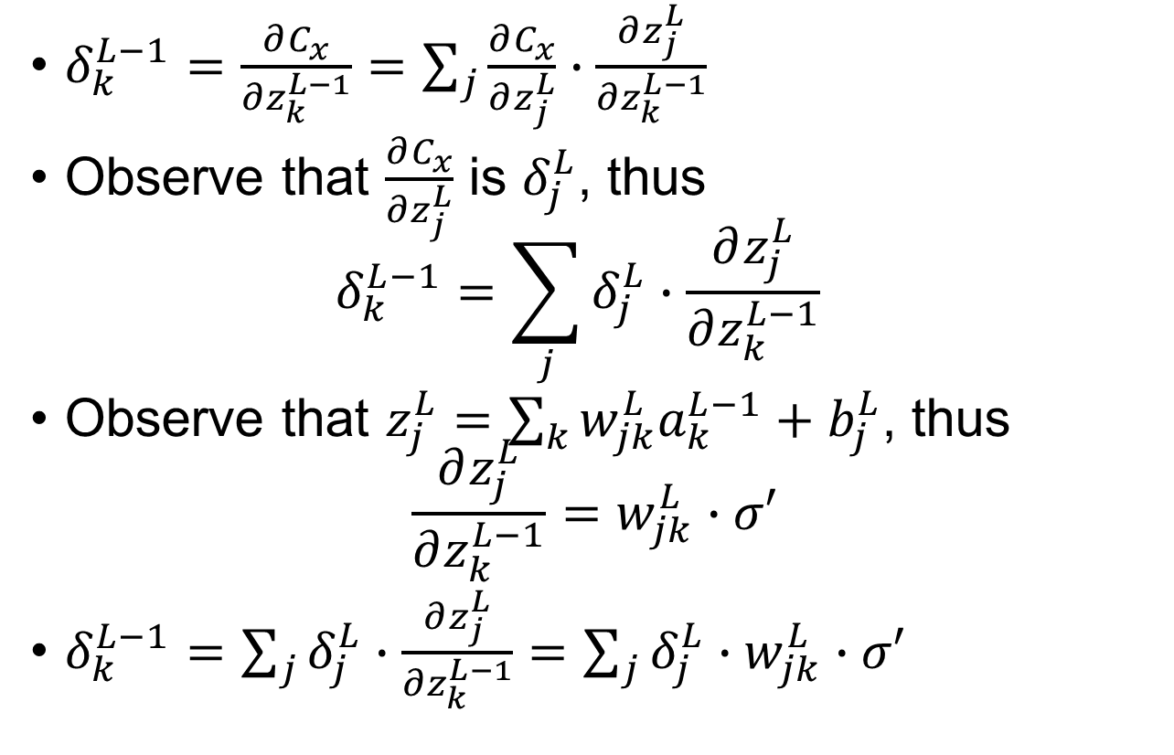
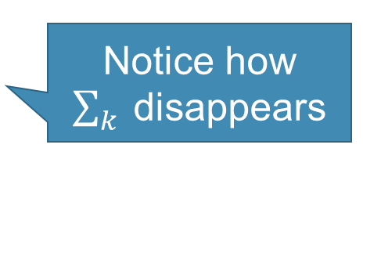
Backpropagation – Corollary 2
$$a_{j}^{L−1}=σ\left(z_{j}^{L−1}\right)$$
Function of $z_{k}^{L−1}$
$$C_{x}=\frac{1}{2}\sum_{j}{{\left(y_{j}−σ\left(\sum_{k}{w_{jk}^{L}a_{k}^{L−1}}+b_{j}^{L}\right)\right)}^{2}}$$
$δ_{k}^{L−1}=\frac{∂C_{x}}{∂z_{k}^{L−1}}=\sum_{j}{\frac{∂C_{x}}{∂z_{j}^{L}}∙\frac{∂z_{j}^{L}}{∂z_{k}^{L−1}}}$
Observe that $\frac{∂C_{x}}{∂z_{j}^{L}}$ is $δ_{j}^{L}$, thus $δ_{k}^{L−1}=\sum_{j}{δ_{j}^{L}∙\frac{∂z_{j}^{L}}{∂z_{k}^{L−1}}}$
Observe that $z_{j}^{L}=\sum_{k}{w_{jk}^{L}a_{k}^{L−1}}+b_{j}^{L}$, thus $\frac{∂z_{j}^{L}}{∂z_{k}^{L−1}}=w_{jk}^{L}∙σ′$
$δ_{k}^{L−1}=\sum_{j}{δ_{j}^{L}∙\frac{∂z_{j}^{L}}{∂z_{k}^{L−1}}}=\sum_{j}{δ_{j}^{L}∙w_{jk}^{L}∙σ′ }$
$z_{j}^{L}$ a function of $z_{j}^{L−1}$
We can apply Corollary 1 to calculate $δ_{j}^{L}$
“Follow” the red lines
$$a_{1}^{L}, y_{1}$$
Notice how $\sum_{k}{ }$disappears
$$C_{x}$$
$$j$$
$$a_{j}^{L}, y_{j}$$
$$k$$
$$σ\left(z_{j}^{L}\right)$$

Slide 6








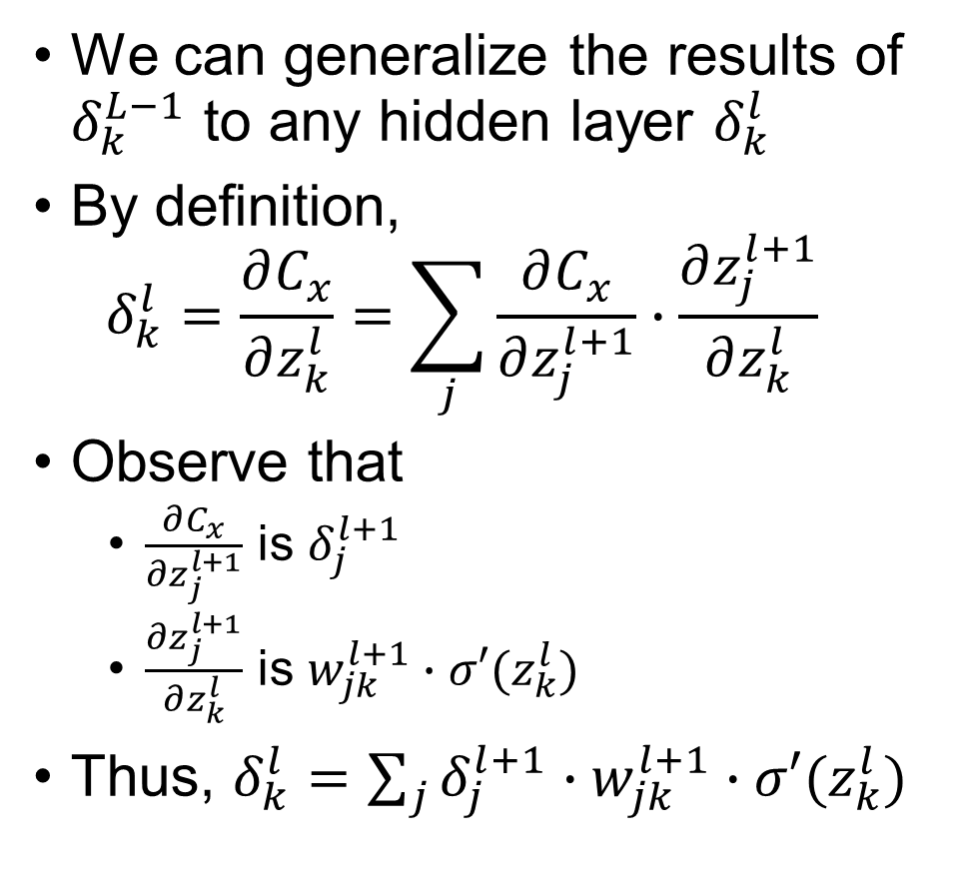
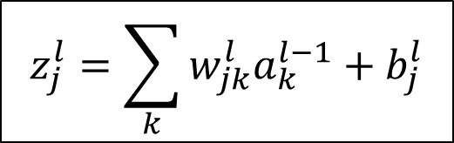
Backpropagation – Corollary 2
$$a_{j}^{l}=σ\left(z_{j}^{l}\right)$$
$$z_{j}^{l}=\sum_{k}{w_{jk}^{l}a_{k}^{l−1}}+b_{j}^{l}$$
We can generalize the results of $δ_{k}^{L−1}$ to any hidden layer $δ_{k}^{l}$
By definition, $δ_{k}^{l}=\frac{∂C_{x}}{∂z_{k}^{l}}=\sum_{j}{\frac{∂C_{x}}{∂z_{j}^{l+1}}∙\frac{∂z_{j}^{l+1}}{∂z_{k}^{l}}}$
Observe that
$\frac{∂C_{x}}{∂z_{j}^{l+1}}$ is $δ_{j}^{l+1}$
$\frac{∂z_{j}^{l+1}}{∂z_{k}^{l}}$ is $w_{jk}^{l+1}∙σ′(z_{k}^{l})$
Thus, $δ_{k}^{l}=\sum_{j}{δ_{j}^{l+1}∙w_{jk}^{l+1}∙σ′(z_{k}^{l})}$
$$z_{1}^{l+1}$$
$$w_{1k}^{l+1}$$
$$z_{2}^{l+1}$$
$$z_{k}^{l}$$
$$w_{2k}^{l+1}$$
$$w_{jk}^{l+1}$$
$$z_{j}^{l+1}$$

Slide 7

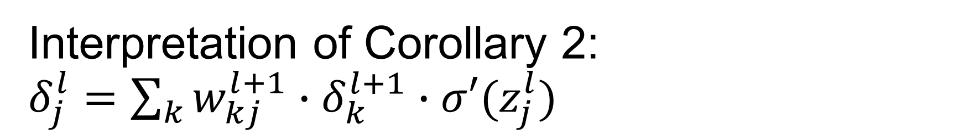




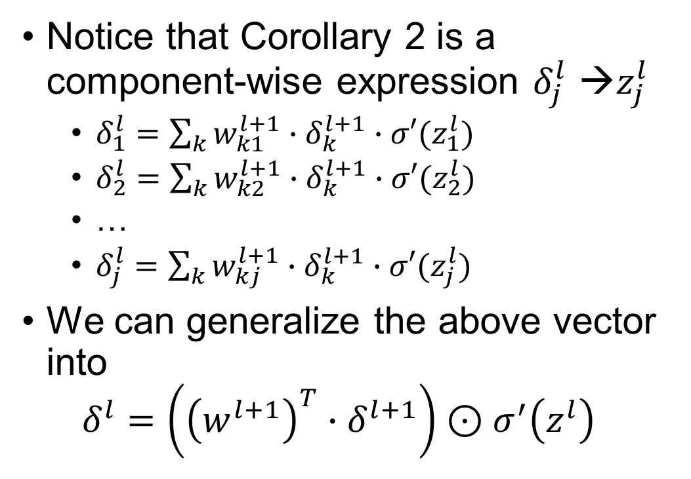

Interpretation of Corollary 2: $δ_{j}^{l}=\sum_{k}{w_{kj}^{l+1}∙δ_{k}^{l+1}∙σ′(z_{j}^{l})}$
We swap $j$ and $k$ for persistency notation with Corollary 1
Notice that Corollary 2 is a component-wise expression $δ_{j}^{l}$ →$z_{j}^{l}$
$δ_{1}^{l}=\sum_{k}{w_{k1}^{l+1}∙δ_{k}^{l+1}∙σ′(z_{1}^{l})}$
$δ_{2}^{l}=\sum_{k}{w_{k2}^{l+1}∙δ_{k}^{l+1}∙σ′(z_{2}^{l})}$
…
$δ_{j}^{l}=\sum_{k}{w_{kj}^{l+1}∙δ_{k}^{l+1}∙σ′(z_{j}^{l})}$
We can generalize the above vector into $δ^{l}=\left({\left(w^{l+1}\right)}^{T}∙δ^{l+1}\right)⊙σ^{′}\left(z^{l}\right)$
$$z_{1}^{l+1}$$
$$w_{1j}^{l+1}$$
$$z_{2}^{l+1}$$
$$z_{j}^{l}$$
$$w_{2j}^{l+1}$$
$$w_{kj}^{l+1}$$
Why the transposition?
$$z_{k}^{l+1}$$

Slide 8
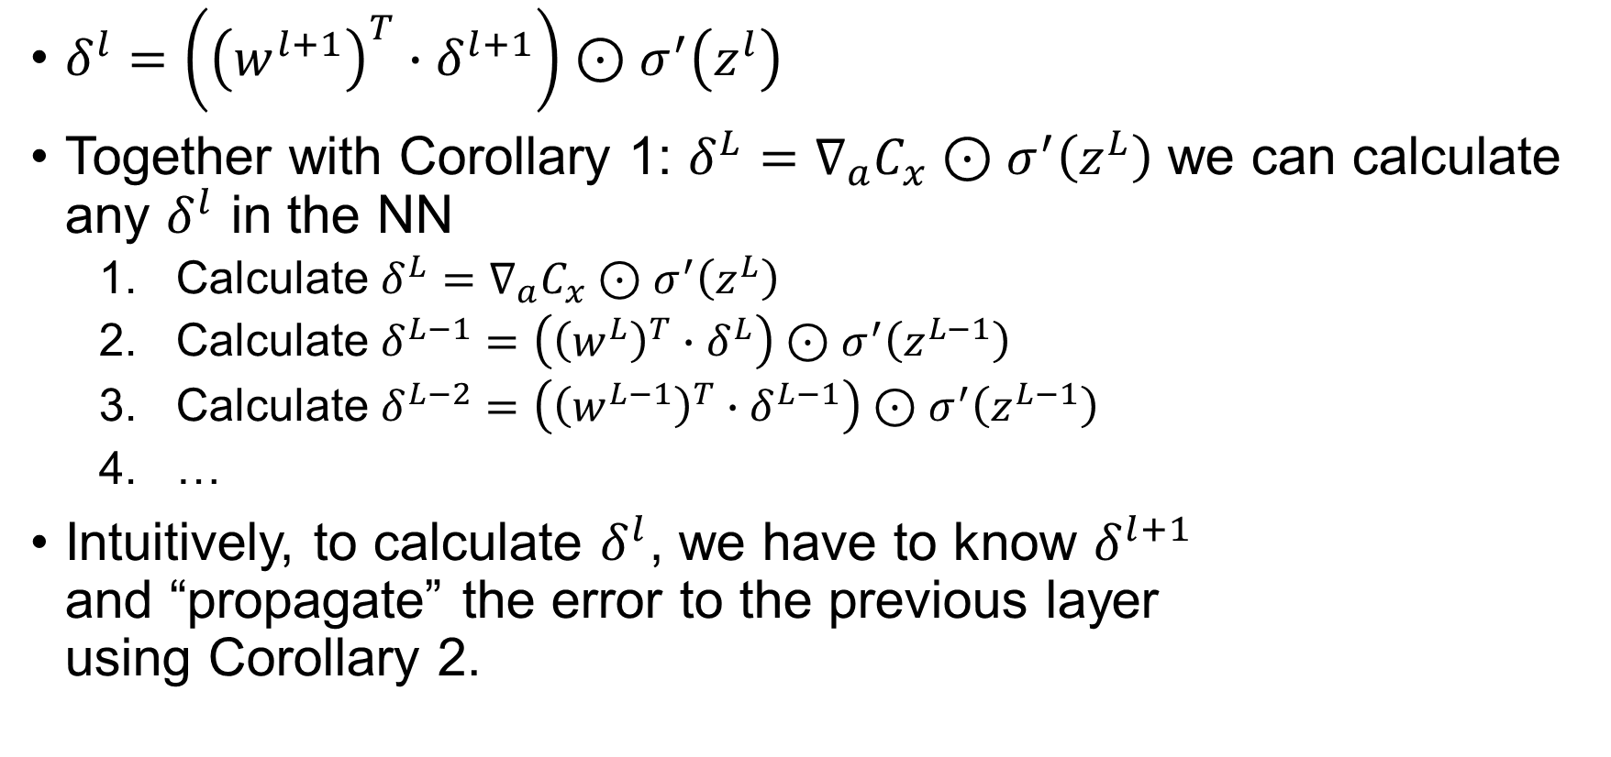
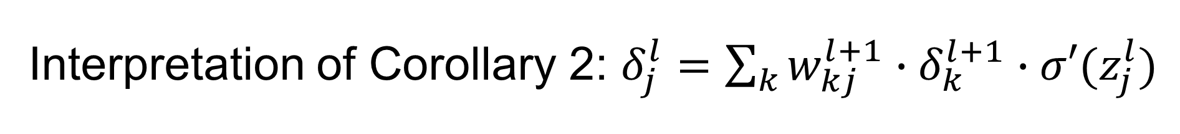
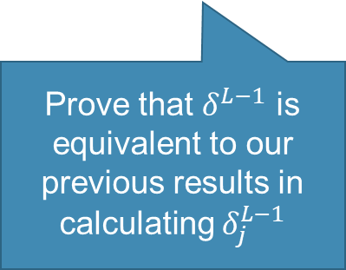
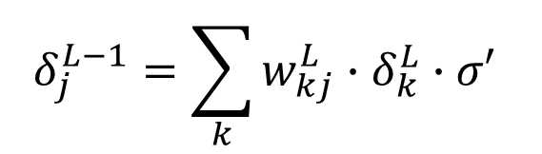
Interpretation of Corollary 2: $δ_{j}^{l}=\sum_{k}{w_{kj}^{l+1}∙δ_{k}^{l+1}∙σ′(z_{j}^{l})}$
$δ^{l}=\left({\left(w^{l+1}\right)}^{T}∙δ^{l+1}\right)⊙σ^{′}\left(z^{l}\right)$
Together with Corollary 1: $δ^{L}=∇_{a}C_{x}⊙σ^{′}\left(z^{L}\right)$ we can calculate any $δ^{l}$ in the NN
Calculate $δ^{L}=∇_{a}C_{x}⊙σ^{′}\left(z^{L}\right)$
Calculate $δ^{L−1}=\left({\left(w^{L}\right)}^{T}∙δ^{L}\right)⊙σ^{′}\left(z^{L−1}\right)$
Calculate $δ^{L−2}=\left({\left(w^{L−1}\right)}^{T}∙δ^{L−1}\right)⊙σ^{′}\left(z^{L−1}\right)$
…
Intuitively, to calculate $δ^{l}$, we have to know $δ^{l+1}$ and “propagate” the error to the previous layer using Corollary 2.
$$δ_{j}^{L−1}=\sum_{k}{{w_{kj}^{L}∙δ}_{k}^{L}∙σ′ }$$
Prove that $δ^{L−1}$ is equivalent to our previous results in calculating $δ_{j}^{L−1}$

Slide 9

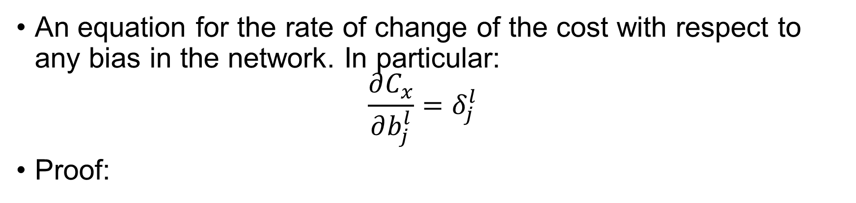
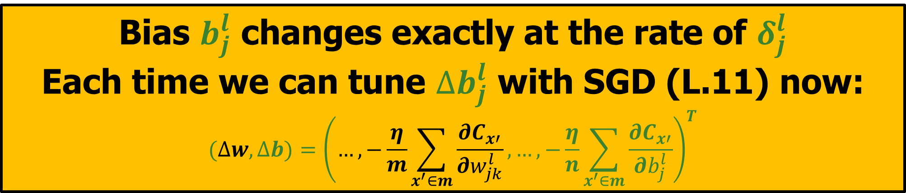

Backpropagation – Corollary 3
An equation for the rate of change of the cost with respect to any bias in the network. In particular: $\frac{∂C_{x}}{∂b_{j}^{l}}=δ_{j}^{l}$
Proof:
$∵z_{j}^{l}=\sum_{k}{w_{jk}^{l}a_{k}^{l−1}}+b_{j}^{l}$ (1)
$∴\frac{∂C_{x}}{∂b_{j}^{l}}=\frac{∂C_{x}}{∂z_{j}^{l}}∙\frac{∂z_{j}^{l}}{∂b_{j}^{l}}$
From (1) we know that $\frac{∂z_{j}^{L}}{∂b_{j}^{L}}=1$
Thus, $\frac{∂C_{x}}{∂b_{j}^{l}}=\frac{∂C_{x}}{∂z_{j}^{l}}=$ $δ_{j}^{l}$
Bias $b_{j}^{l}$ changes exactly at the rate of $δ_{j}^{l}$
Each time we can tune $∆b_{j}^{l}$ with SGD (L.11) now:
$$(∆w,∆b)={\left(…,−\frac{η}{m}\sum_{x^{′}∈m}{\frac{∂C_{x′}}{∂w_{jk}^{l}}},…,−\frac{η}{n}\sum_{x^{′}∈m}{\frac{∂C_{x′}}{∂b_{j}^{l}}}\right)}^{T}$$
$$∎$$

Slide 10


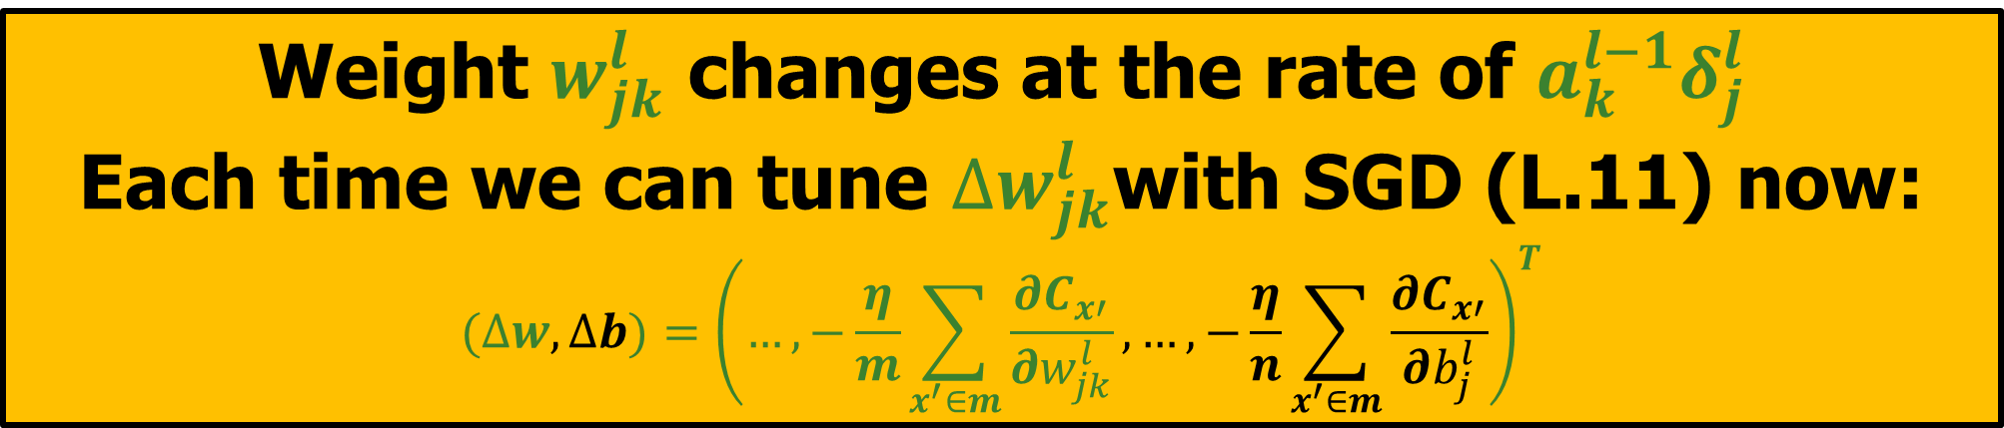
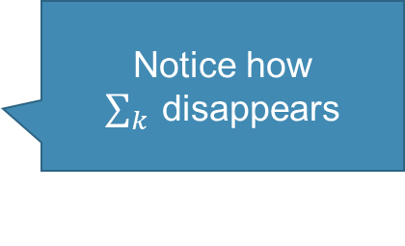

Backpropagation – Corollary 4
An equation for the rate of change of the cost with respect to any weight in the network. In particular: $\frac{∂C_{x}}{∂w_{jk}^{l}}={a_{k}^{l−1}δ}_{j}^{l}$
Proof:
$∵z_{j}^{l}=\sum_{k}{w_{jk}^{l}a_{k}^{l−1}}+b_{j}^{l}$ (1)
$∴\frac{∂C_{x}}{∂w_{jk}^{l}}=\frac{∂C_{x}}{∂z_{j}^{l}}∙\frac{∂z_{j}^{l}}{∂w_{jk}^{l}}$
From (1) we know that $\frac{∂z_{j}^{L}}{∂w_{jk}^{l}}=a_{k}^{l−1}$
Thus, $\frac{∂C_{x}}{∂w_{jk}^{l}}=\frac{∂C_{x}}{∂z_{j}^{l}}{∙a}_{k}^{l−1}=$ ${a_{k}^{l−1}δ}_{j}^{l}$
Weight $w_{jk}^{l}$ changes at the rate of ${a_{k}^{l−1}δ}_{j}^{l}$
Each time we can tune $∆w_{jk}^{l}$with SGD (L.11) now:
$$(∆w,∆b)={\left(…,−\frac{η}{m}\sum_{x^{′}∈m}{\frac{∂C_{x′}}{∂w_{jk}^{l}}},…,−\frac{η}{n}\sum_{x^{′}∈m}{\frac{∂C_{x′}}{∂b_{j}^{l}}}\right)}^{T}$$
Notice how $\sum_{k}{ }$disappears
$$∎$$

Slide 11
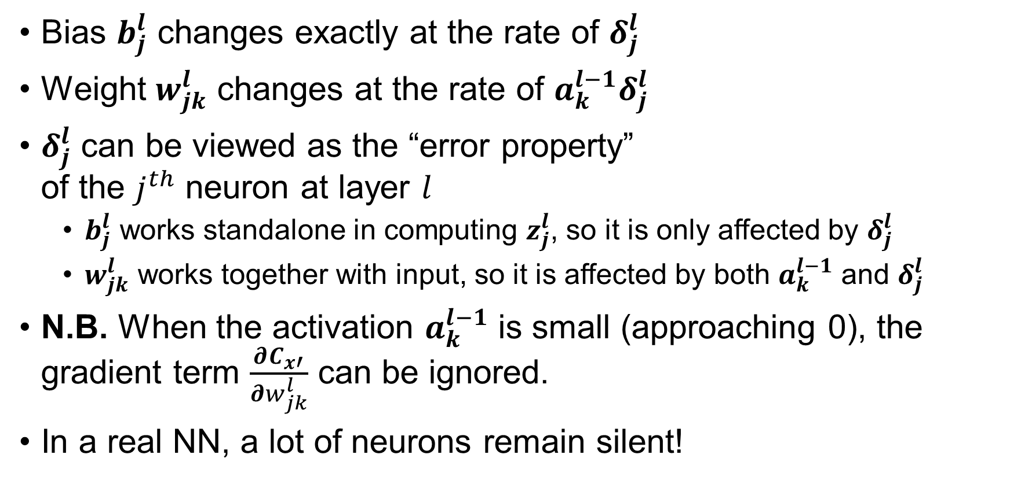




Interpretation of Corollary 3 and 4
Bias $b_{j}^{l}$ changes exactly at the rate of $δ_{j}^{l}$
Weight $w_{jk}^{l}$ changes at the rate of ${a_{k}^{l−1}δ}_{j}^{l}$
$δ_{j}^{l}$ can be viewed as the “error property” of the $j^{th}$ neuron at layer $l$
$b_{j}^{l}$ works standalone in computing $z_{j}^{l}$, so it is only affected by $δ_{j}^{l}$
$w_{jk}^{l}$ works together with input, so it is affected by both $a_{k}^{l−1}$ and $δ_{j}^{l}$
N.B. When the activation $a_{k}^{l−1}$ is small (approaching 0), the gradient term $\frac{∂C_{x′}}{∂w_{jk}^{l}}$ can be ignored.
In a real NN, a lot of neurons remain silent!
$$w_{jk}^{l}$$
$$δ_{j}^{l}$$
$$a_{k}^{l−1}$$
$$b_{j}^{l}$$

Slide 12

Summarizing it up
Corollary 1: $δ^{L}=∇_{a}C_{x}⊙σ^{′}\left(z^{L}\right)$
Corollary 2: $δ^{l}=\left({\left(w^{l+1}\right)}^{T}∙δ^{l+1}\right)⊙σ^{′}\left(z^{l}\right)$
Corollary 3: $\frac{∂C_{x}}{∂b_{j}^{l}}=δ_{j}^{l}$
Corollary 4: $\frac{∂C_{x}}{∂w_{jk}^{l}}={a_{k}^{l−1}δ}_{j}^{l}$

Slide 13
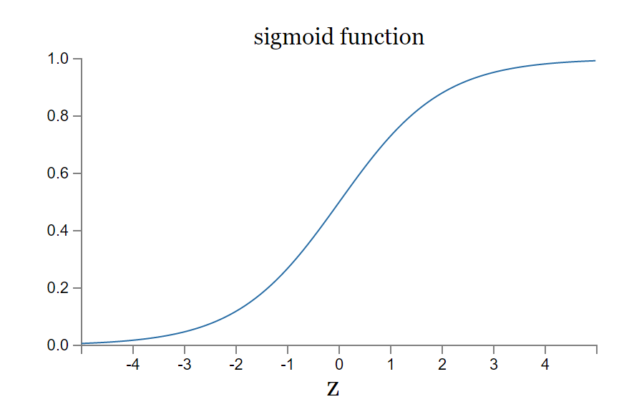
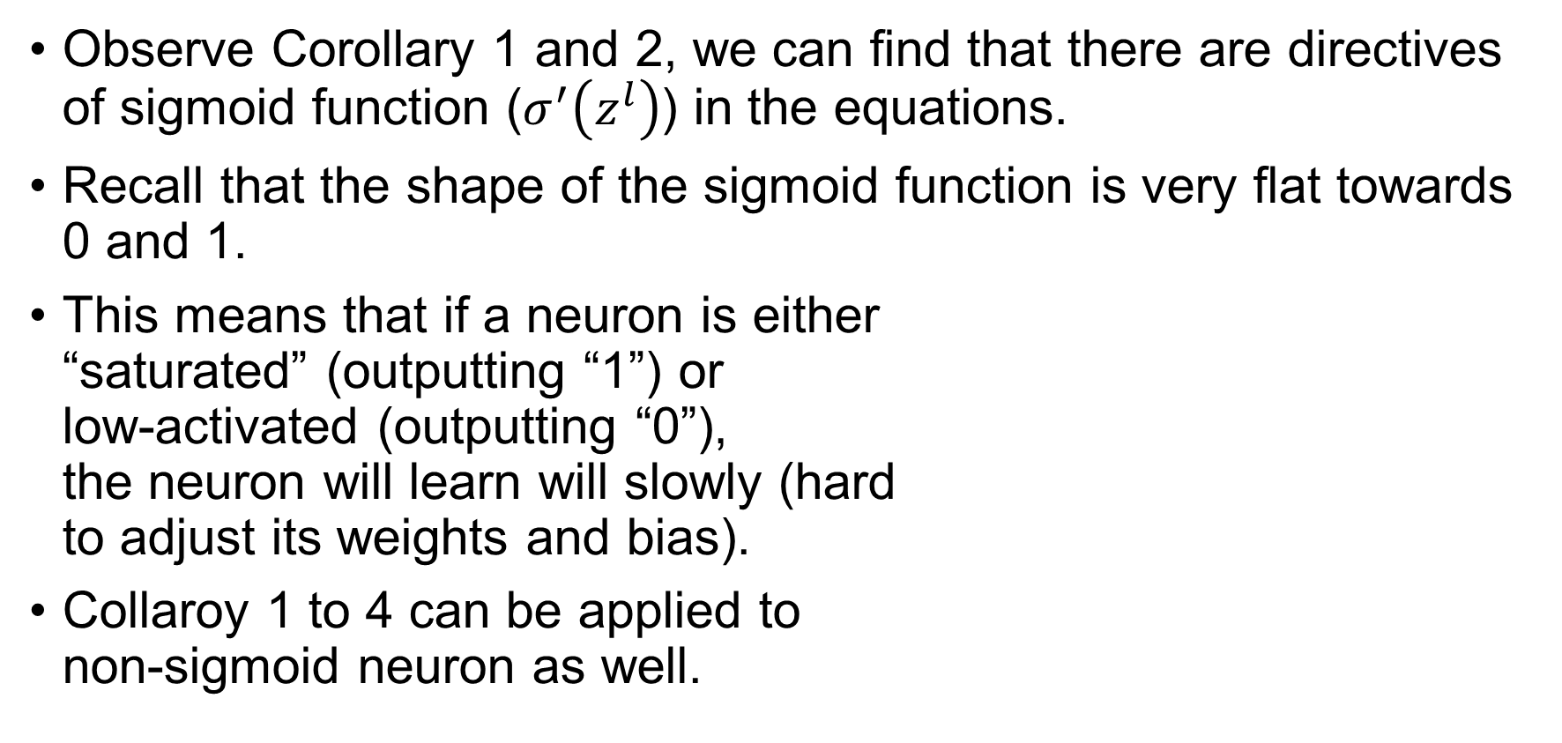

Some other insights
Observe Corollary 1 and 2, we can find that there are directives of sigmoid function ($σ^{′}\left(z^{l}\right)$) in the equations.
Recall that the shape of the sigmoid function is very flat towards 0 and 1.
This means that if a neuron is either “saturated” (outputting “1”) or low-activated (outputting “0”), the neuron will learn will slowly (hard to adjust its weights and bias).
Collaroy 1 to 4 can be applied to non-sigmoid neuron as well.
$$σ\left(z\right)=\frac{1}{1+e^{−\left(w ∙ x + b\right)}} \\ =\frac{1}{1+e^{−z}}$$

Slide 14
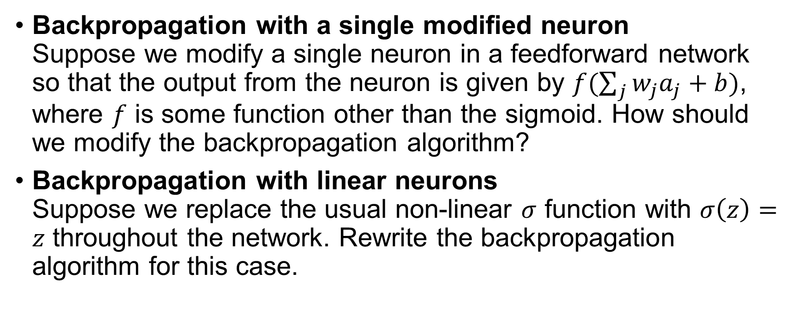
Exercise
Backpropagation with a single modified neuron Suppose we modify a single neuron in a feedforward network so that the output from the neuron is given by $f(\sum_{j}{w_{j}a_{j}+b})$, where $f$ is some function other than the sigmoid. How should we modify the backpropagation algorithm?
Backpropagation with linear neurons Suppose we replace the usual non-linear $σ$ function with $σ\left(z\right)=z$ throughout the network. Rewrite the backpropagation algorithm for this case.

Slide 15
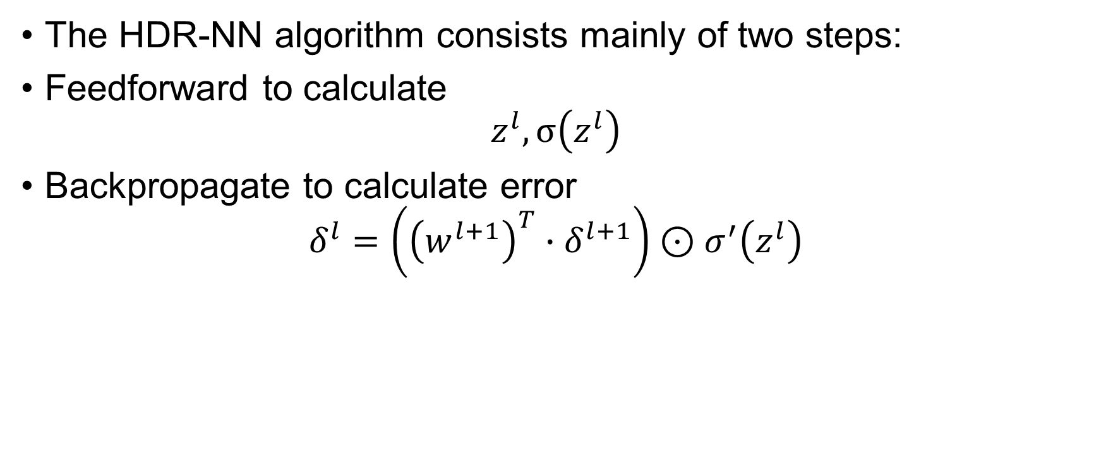
HDR-NN algorithm – overview
The HDR-NN algorithm consists mainly of two steps:
Feedforward to calculate $z^{l}, σ\left(z^{l}\right)$
Backpropagate to calculate error $δ^{l}=\left({\left(w^{l+1}\right)}^{T}∙δ^{l+1}\right)⊙σ^{′}\left(z^{l}\right)$

Slide 16
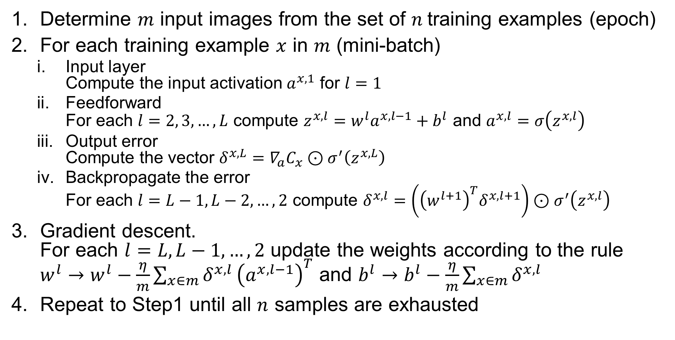
HDR-NN algorithm – the complete steps
Determine $m$ input images from the set of $n$training examples (epoch)
For each training example $x$ in $m$ (mini-batch)
Input layer Compute the input activation $a^{x, 1}$ for $l=1$
Feedforward For each $l=2, 3, …, L$ compute $z^{x, l}=w^{l}a^{x, l−1}+b^{l}$ and $a^{x, l}=σ\left(z^{x, l}\right)$
Output error Compute the vector $δ^{x,L}=∇_{a}C_{x}⊙σ^{′}\left(z^{x,L}\right)$
Backpropagate the error For each $l=L−1, L−2, …, 2$ compute $δ^{x,l}=\left({\left(w^{l+1}\right)}^{T}δ^{x,l+1}\right)⊙σ^{′}\left(z^{x,l}\right)$
Gradient descent. For each $l=L, L−1, …, 2$ update the weights according to the rule $w^{l}→w^{l}−\frac{η}{m}\sum_{x∈m}{δ^{x,l}}{\left(a^{x, l−1}\right)}^{T}$ and $b^{l}→b^{l}−\frac{η}{m}\sum_{x∈m}{δ^{x,l}}$
Repeat to Step1 until all $n$ samples are exhausted
Accelerating them using FPGA!

Slide 17

Questions?

